Slide 1
Plotting in Python

Slide 2
Matplotlib is a tool for data visualization and this tool built upon the Numpy and Scipy framework.
It was developed by John Hunter in 2002. Matplotlib is a library for making 2D plots of arrays in Python.
Matplotlib also able to create simple plots with just a few commands and along with limited 3D graphic support.
It can provide quality graph/figure in interactive environment across platforms
Can also be used for animations

Slide 3
advantages of MatPlotLib
It could be used on any operating system via its array of backend.
It has a familiar interface: one similar to MatLab it had a coherent vision: to do 2D graphics, and do them well.
Great control of every element in a figure, including figure size and DPI.
High-quality output in many formats, including PNG, PDF, SVG, EPS, and PGF.

Slide 4
Line Plots
plot() is a versatile command, and will take an arbitrary number of arguments.
plt.plot([1, 2, 3, 4], [1, 4, 9, 16])
For every x, y pair of arguments, there is an optional third argument which is the format string that indicates the color and line type of the plot.
The letters and symbols of the format string are from MATLAB, and you concatenate a color string with a line style string.
The default format string is ‘b-‘, which is a solid blue line.

Slide 5
Show() Vs draw()
plt.show() will display the current figure that you are working on.
plt.draw() will re-draw the figure. This allows you to work in interactive mode and, should you have changed your data or formatting, allow the graph itself to change.

Slide 6
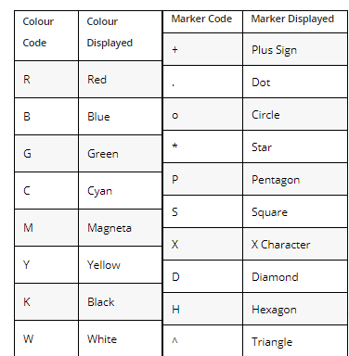

Slide 7
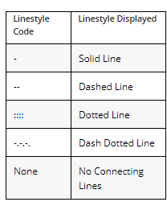

Slide 8
numpy.random.randn
numpy.random.randn(d0, d1, ..., dn)Return a sample (or samples) from the “standard normal” distribution.
If positive, int_like or int-convertible arguments are provided, randn generates an array of shape (d0, d1, ..., dn), filled with random floats sampled from a univariate “normal” (Gaussian) distribution of mean 0 and variance 1 (if any of the are floats, they are first converted to integers by truncation).
A single float randomly sampled from the distribution is returned if no argument is provided.

Slide 9
Scatter plot
A scatter plot of y vs x with varying marker size and/or color.
x, y : array_like, shape (n, )The data positions.
c : color, sequence, or sequence of color, optional, default: 'b'

Slide 10
Histogram
Plot a histogram.
Compute and draw the histogram of x. The return value is a tuple (n, bins, patches) or ([n0, n1, ...], bins, [patches0, patches1,...]) if the input contains multiple data.
Ticks- We are going to change x axis label ticks and y label ticks

